Slide 1
Part 1: Location

Slide 2
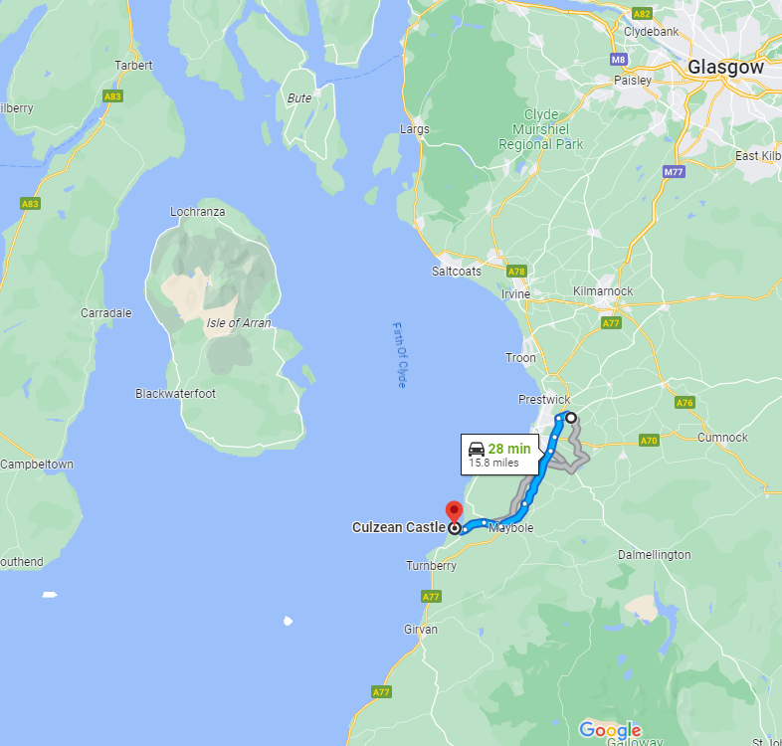
Rain data from Culzean
Solar data from Auchincruvie

Slide 3
Part 2: Interpreting Data

Slide 4
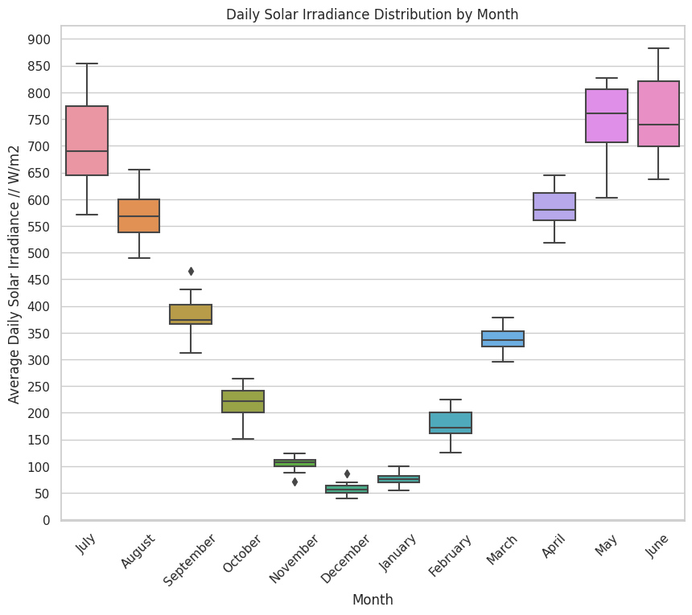
Daily irradiance averaged monthly
Distribution plotted for each month in the 16 years in the data

Slide 5
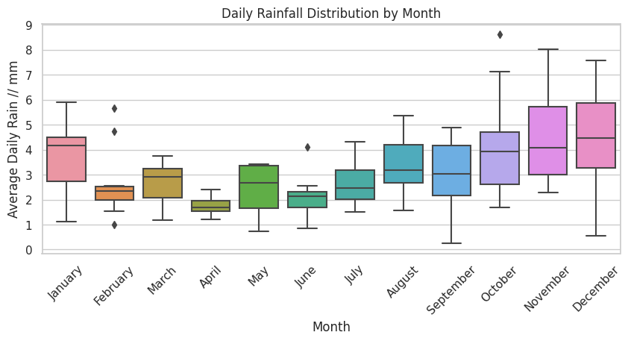
Daily rainfall averaged monthly
Distribution plotted for each month in the 18 years of data

Slide 6
Part 3: Solar Power
For Auchincruive 2005-2020

Slide 7
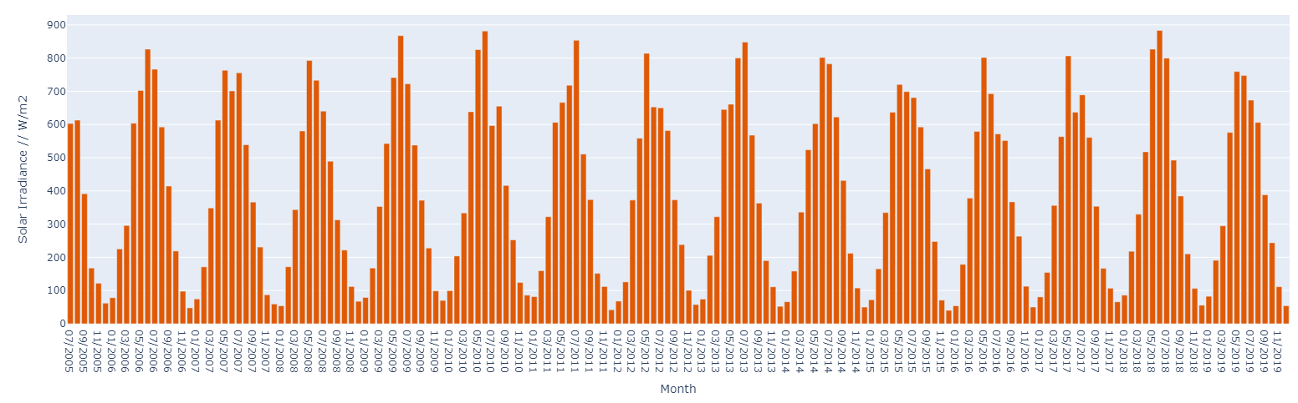
Average Daily Solar Irradiance (By Month)

Slide 8
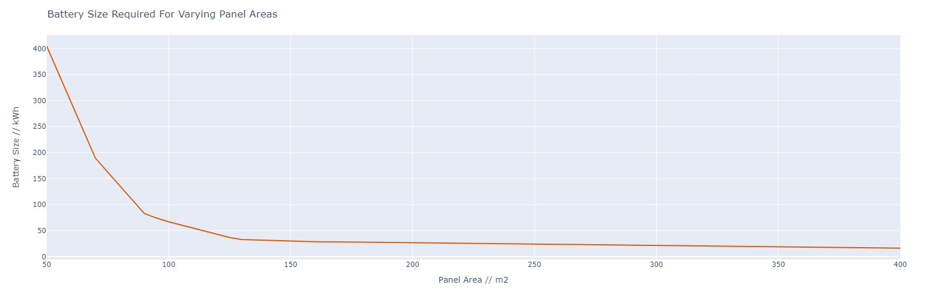
Battery Size to Maintain Power Year Round

Slide 9
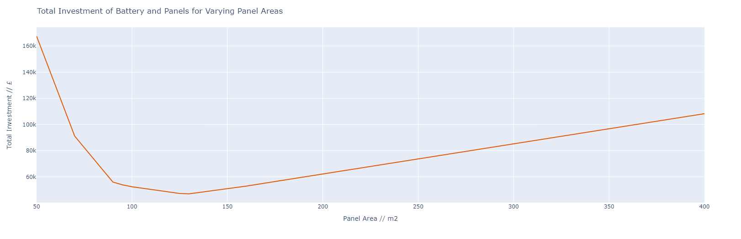
Battery and Solar Panel Cost Optimisation
Cost optimised with $130m^{2}$ of solar panels (and 33kWh battery)

Slide 10
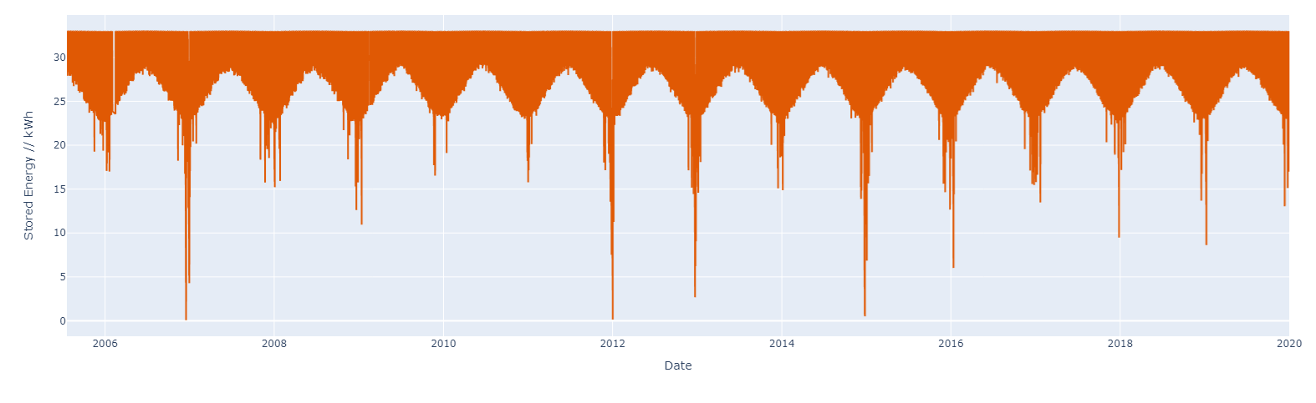

Stored Energy With Time
For a panel area of $130m^{2}$ a$33kWh$ battery is never fully depleted
Excess energy can be sold back to the grid
The initial investment is ~£47000

Slide 11
Part 4: Water
For Culzean 2000-2017

Slide 12
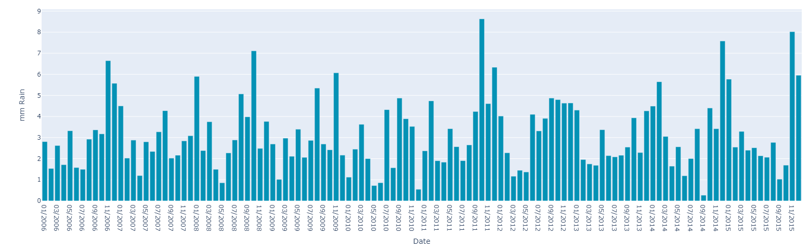
Average Daily Rainfall (By Month)

Slide 13
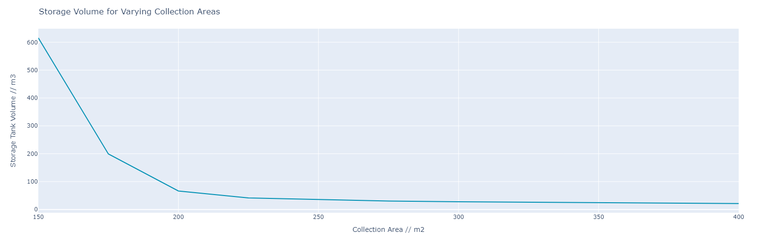
Storage Volume to Maintain Water Supply
Volume reduction significantly slow for area $>300m^{2}$

Slide 14
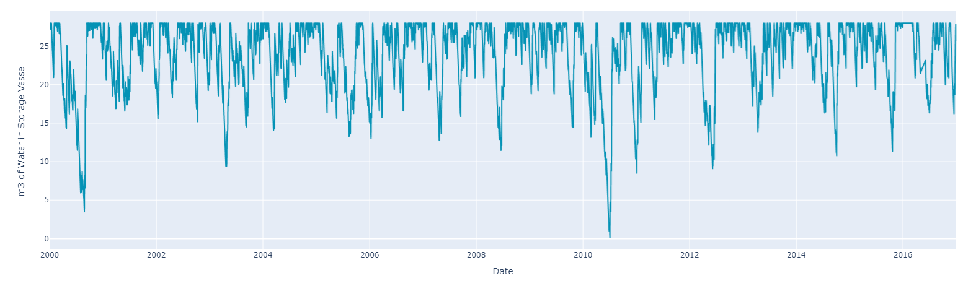
Stored Water With Time
A volume of $28m^{3}$ and collection area of $300m^{2}$ can withstand a once-in-10-year low rainfall month
The water tank has a cost of ~£39300

Slide 15
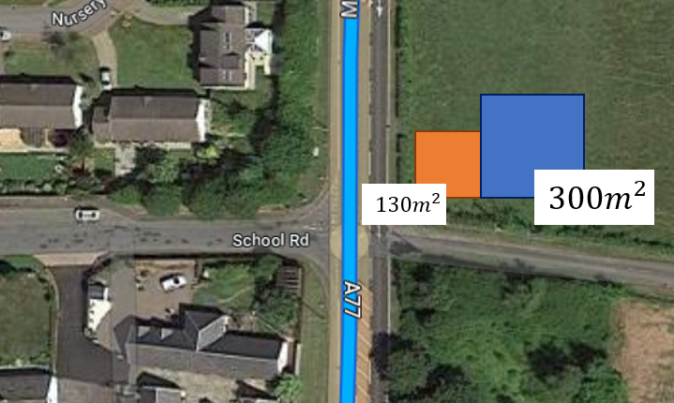
Part 5: Conclusions
Possible? – Yes (with some key assumptions)
Expensive? – Yes
Land intensive? – Moderate
Investment = £86300
Assumes:
Rainwater never spoils once collected
15% of solar irradiance is always collected
Water and energy use is constant every day of the year
There is never a month with:
Less rain than July 2010
Less solar irradiance than December 2006

Slide 16
Bonus: What About Wind?
For Prestwick 2012-2020

Slide 17
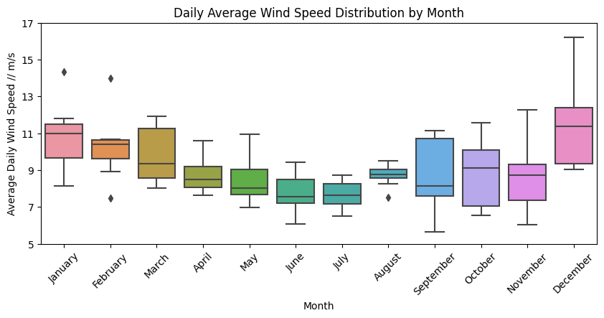
Daily wind speed averaged monthly
Distribution plotted for each month in the 8 years of data
More consistent than solar irradiance

Slide 18
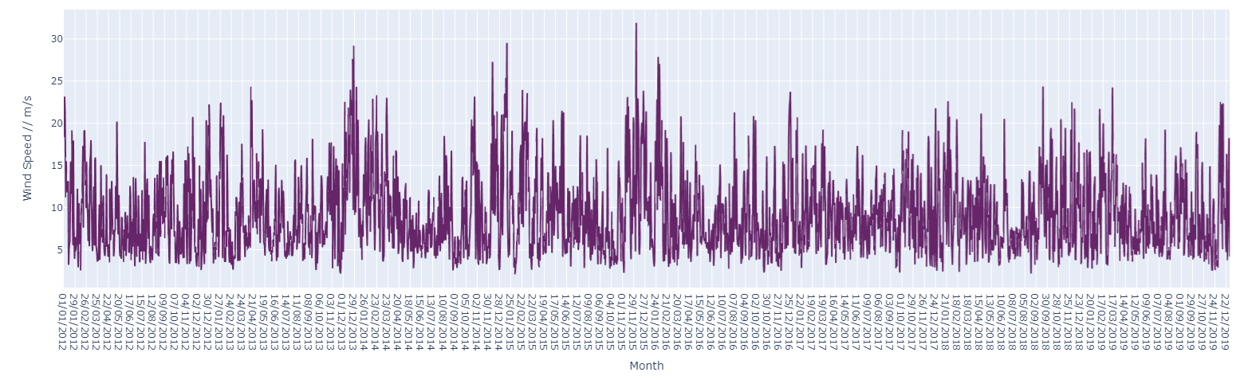
Average Daily Windspeed

Slide 19
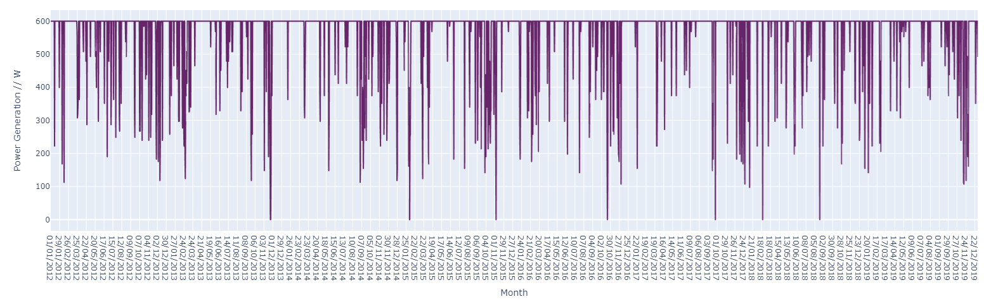
Average Daily Power Production
For a turbine:
Rated for 2kWh
With a coefficient of performance of 0.3
Blade length of 3.2m
Minimum wind speed of 2.5m/s
And maximum production at 15m/s

Slide 20
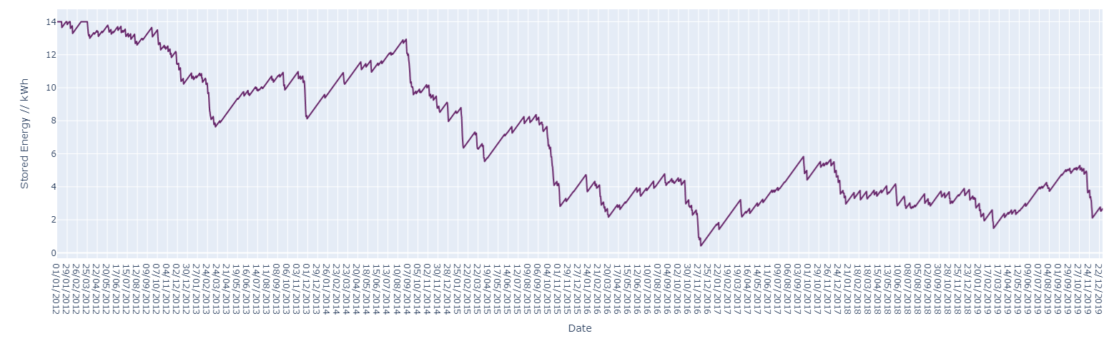
Stored Energy With Time (Wind Only)
A battery of 14kWh is sufficient for the period
Gradual decrease due to low wind days and low turbine production
Can be supplemented with a few solar panels

Slide 21
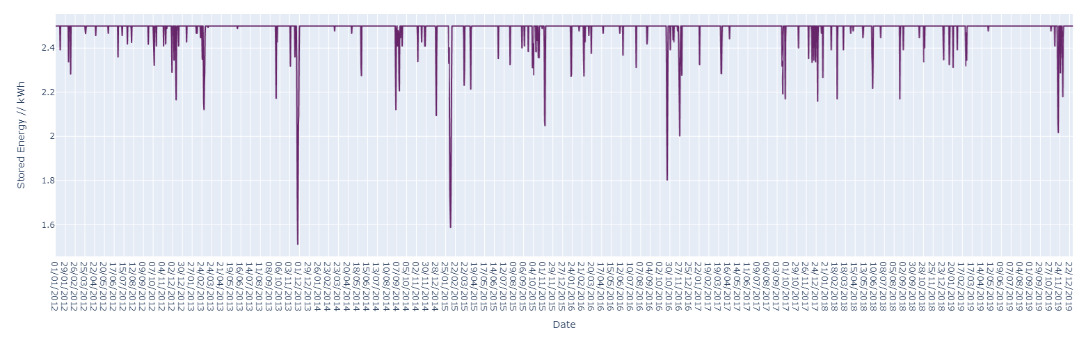
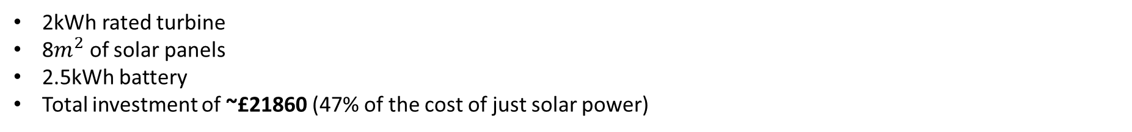
Stored Energy With Time (Wind and Solar)
2kWh rated turbine
8$m^{2}$ of solar panels
2.5kWh battery
Total investment of ~£21860 (47% of the cost of just solar power)

